Slide 1
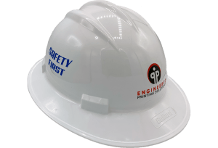
Hardhat Detection
By Minjae Cho

Slide 2
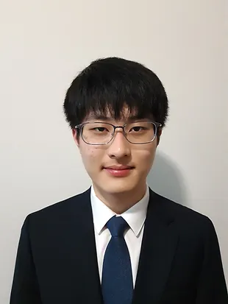
About Me
My mission in ISM is to develop computer science knowledge and its various applications, while also developing presentation skills such as confidence, public speaking, and professionalism. Throughout ISM, I want to use computer science in conjunction with different fields to create something useful and easier for others in that field, or general population.

Slide 3

About Mentor
My mentor, Rahul Mukherjee, is a professional who loves problem solving with data. In the past, he had many experiences such as working as a Data Engineer where he was responsible for running large-scale production data systems, building scalable back-end systems across the data stack, and implementing ETL processes and building dashboards at Bosch. Adding on his pre-existing knowledge and experience in the field of data science, his objective is to learn more about both the technical and business aspects of how data-driven decisions are made.

Slide 4
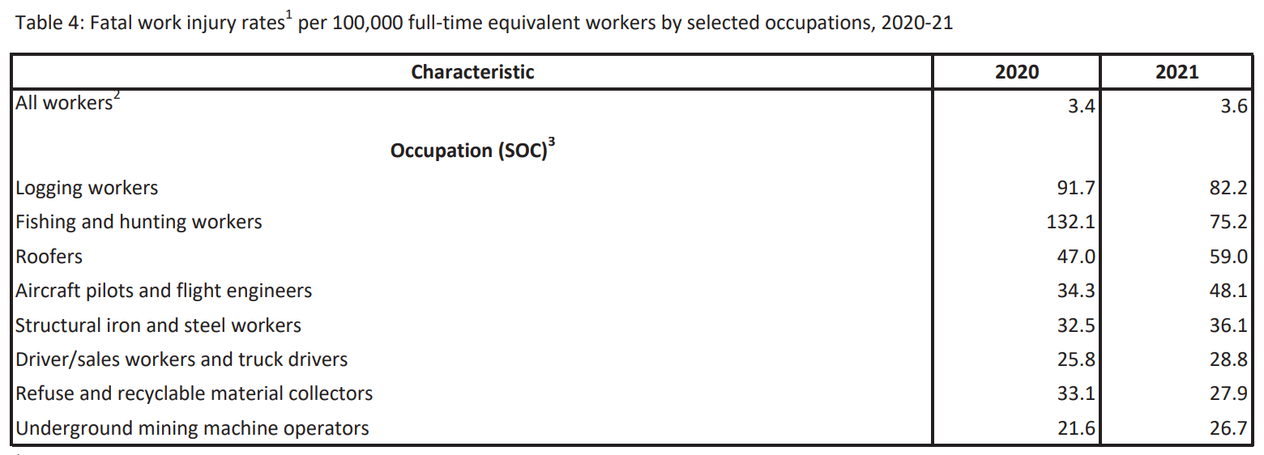
Why hardhats?
Notes:
https://www.bls.gov/news.release/pdf/cfoi.pdf
Construction related occupations have one of the highest fatal work injury rates
Unlike other occupations, it actually increased from 2020 to 2021

Slide 5
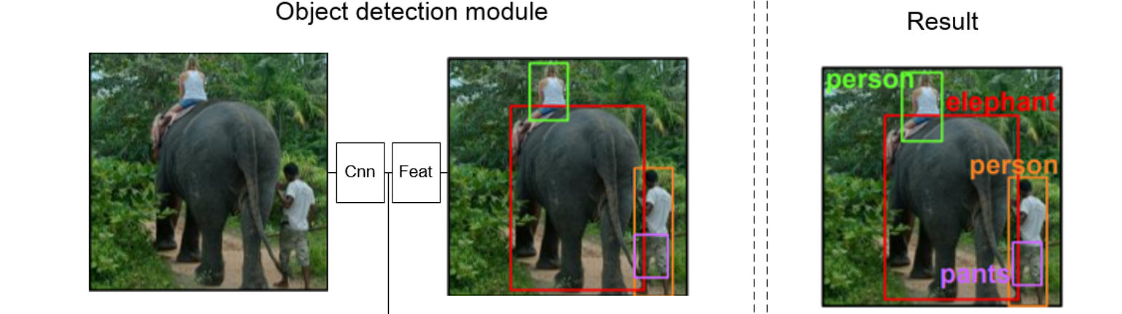
What is Object Detection?
Object detection is computer vision technique for locating instances of objects in images or videos.

Slide 6
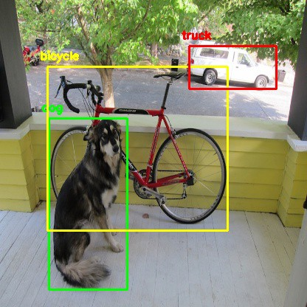
You Only Look Once (YOLO)
YOLO is an abbreviation for the term 'You Only Look Once,' an open-source algorithm that detects and recognizes various objects in a picture or video.

Slide 7
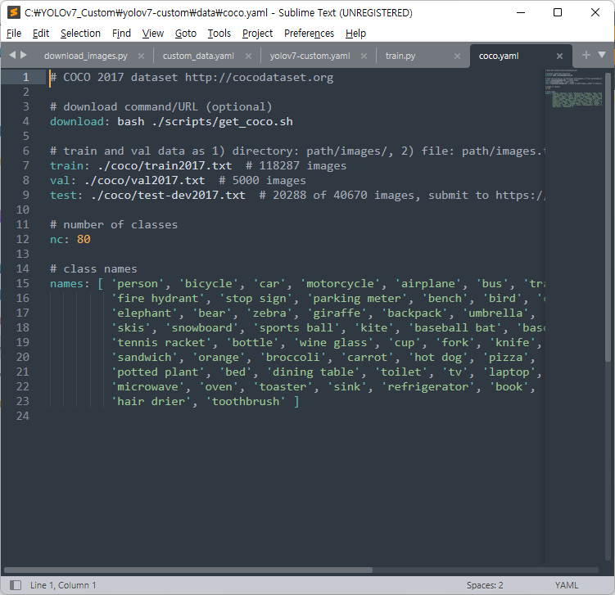
Custom Objects
There are objects already detectable in YOLO by default. However, I created a custom object, hardhat, to be detected.
Default Objects

Slide 8
Creating Custom Object
Step 04
Step 03
Step 02
Step 01
Training
Annotating
Gathering
Set Up

Slide 9
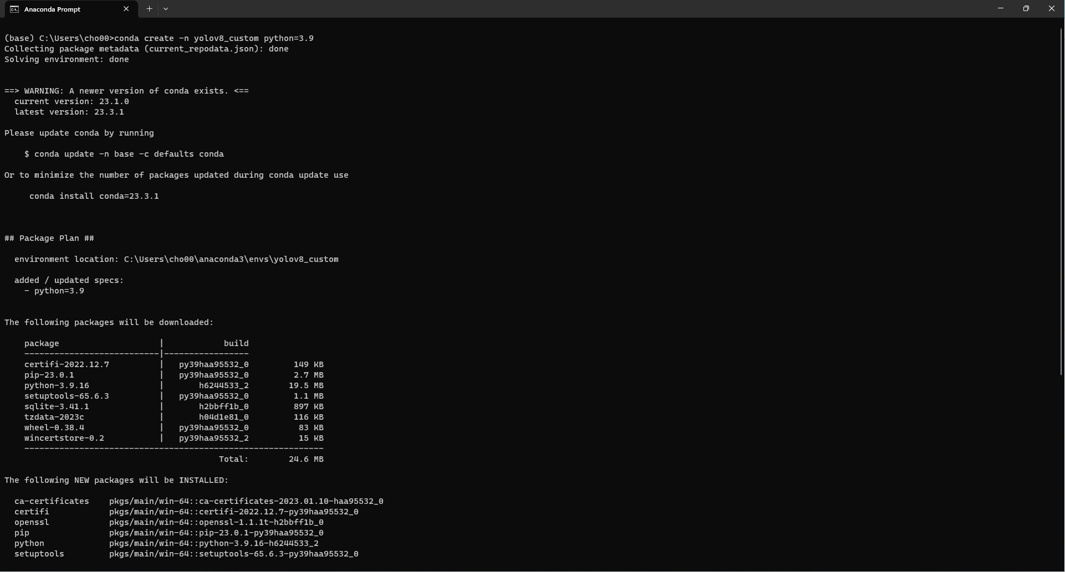
Setting Up Virtual Environment
Using Anaconda prompt and Python, I set up virtual environment to use small applications and YOLOv8 on.

Slide 10
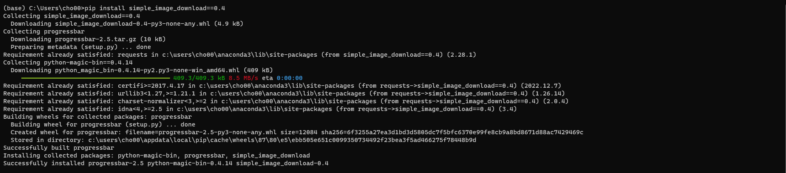
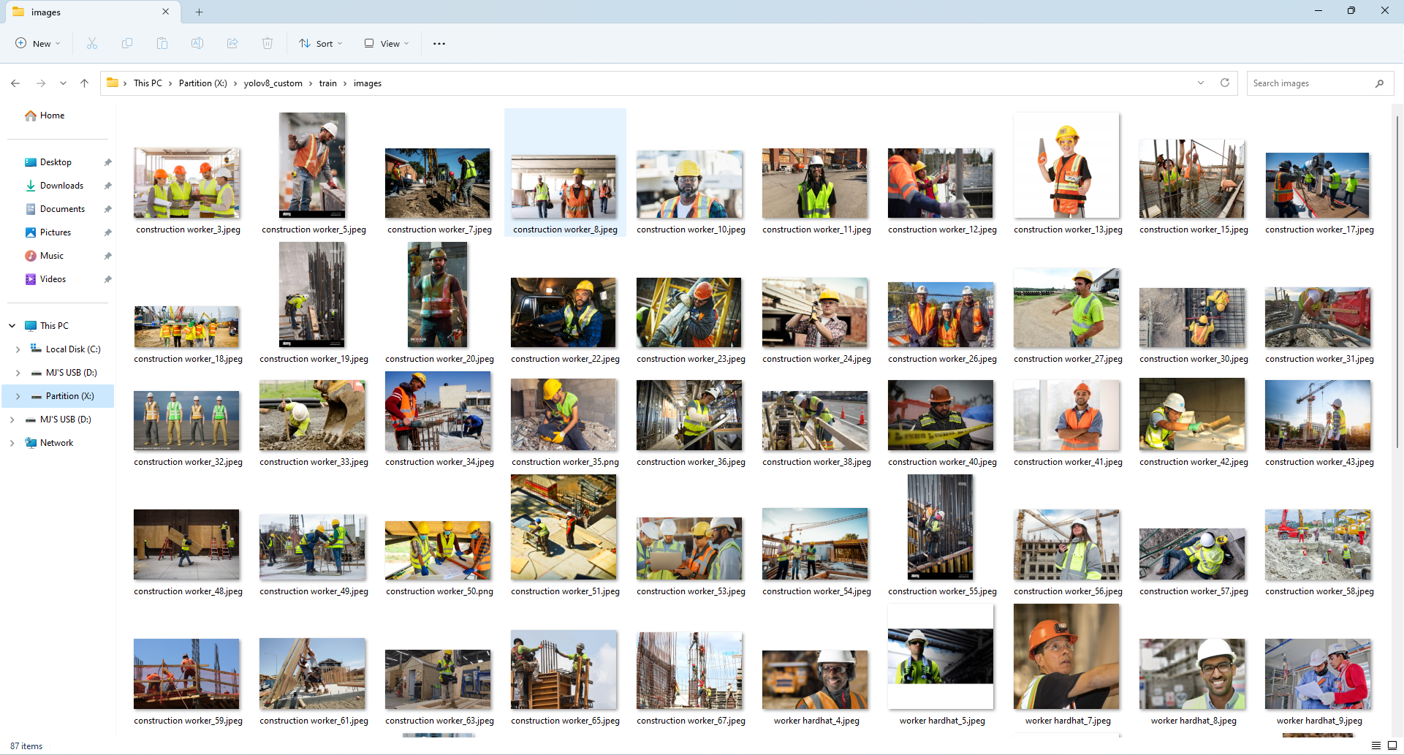
Gathering Image Samples
Using a tool to gather images from Google, I created image samples. Then, I manually sorted through them to remove images that does not fit my needs, such as cliparts and duplicates.
Installing tool on virtual environment
Images (after sorting)

Slide 11
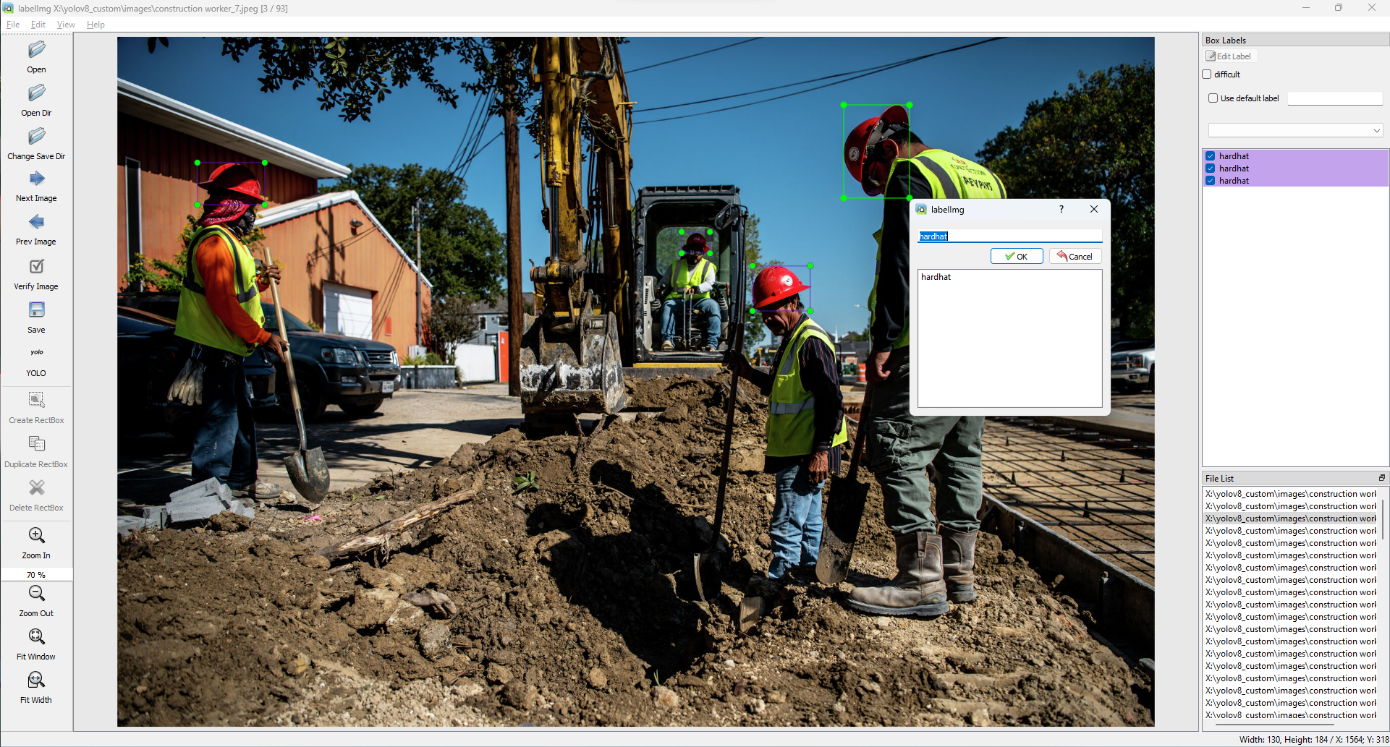
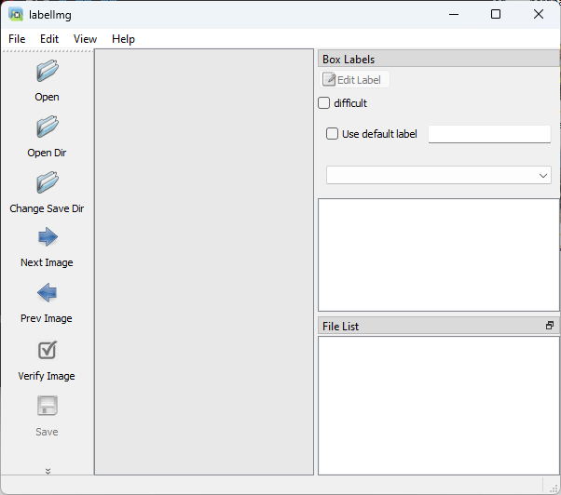
Annotating Images
Using another tooled called ‘labelImg,’ I annotated all the images I gathered to prepare training model.
labelImg
labelImg in use

Slide 12
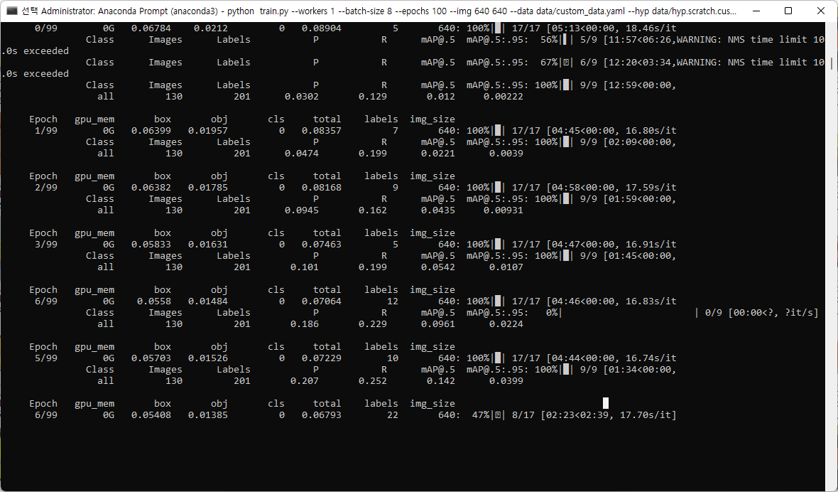
Training Hardhat Detection Model
Finally, using the annotated images, I trained a custom model to detect hardhats.
Training in action

Slide 13
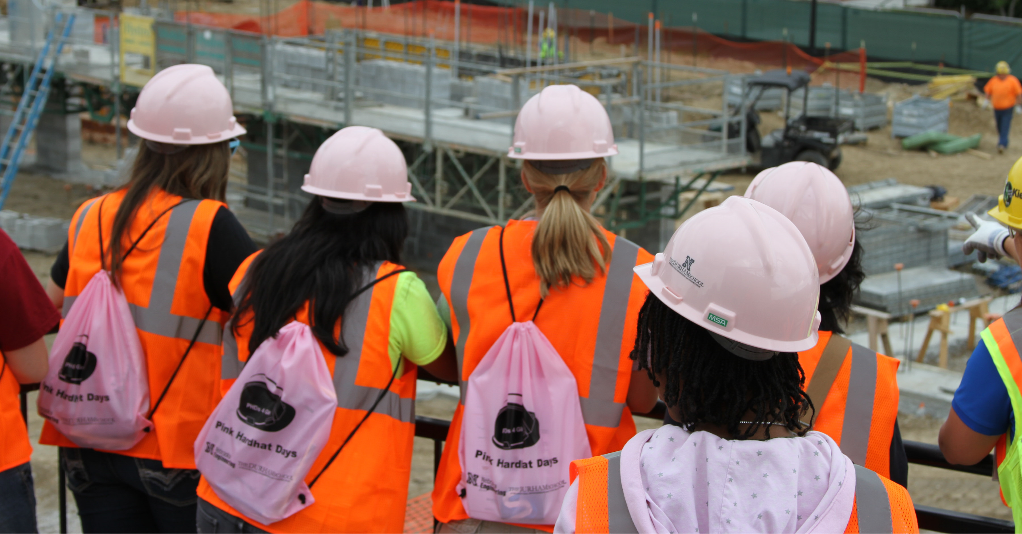

Slide 14
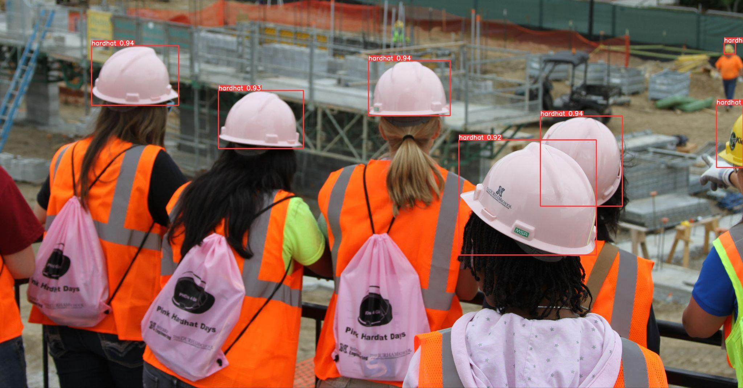

Slide 15
The Statistics
01
02
03
Labels
Confusion Matrix
Performance Metrics
Just some fun statistics of the image annotations
How accurate is the model?
More in depth strengths & weaknesses of various metrics

Slide 16
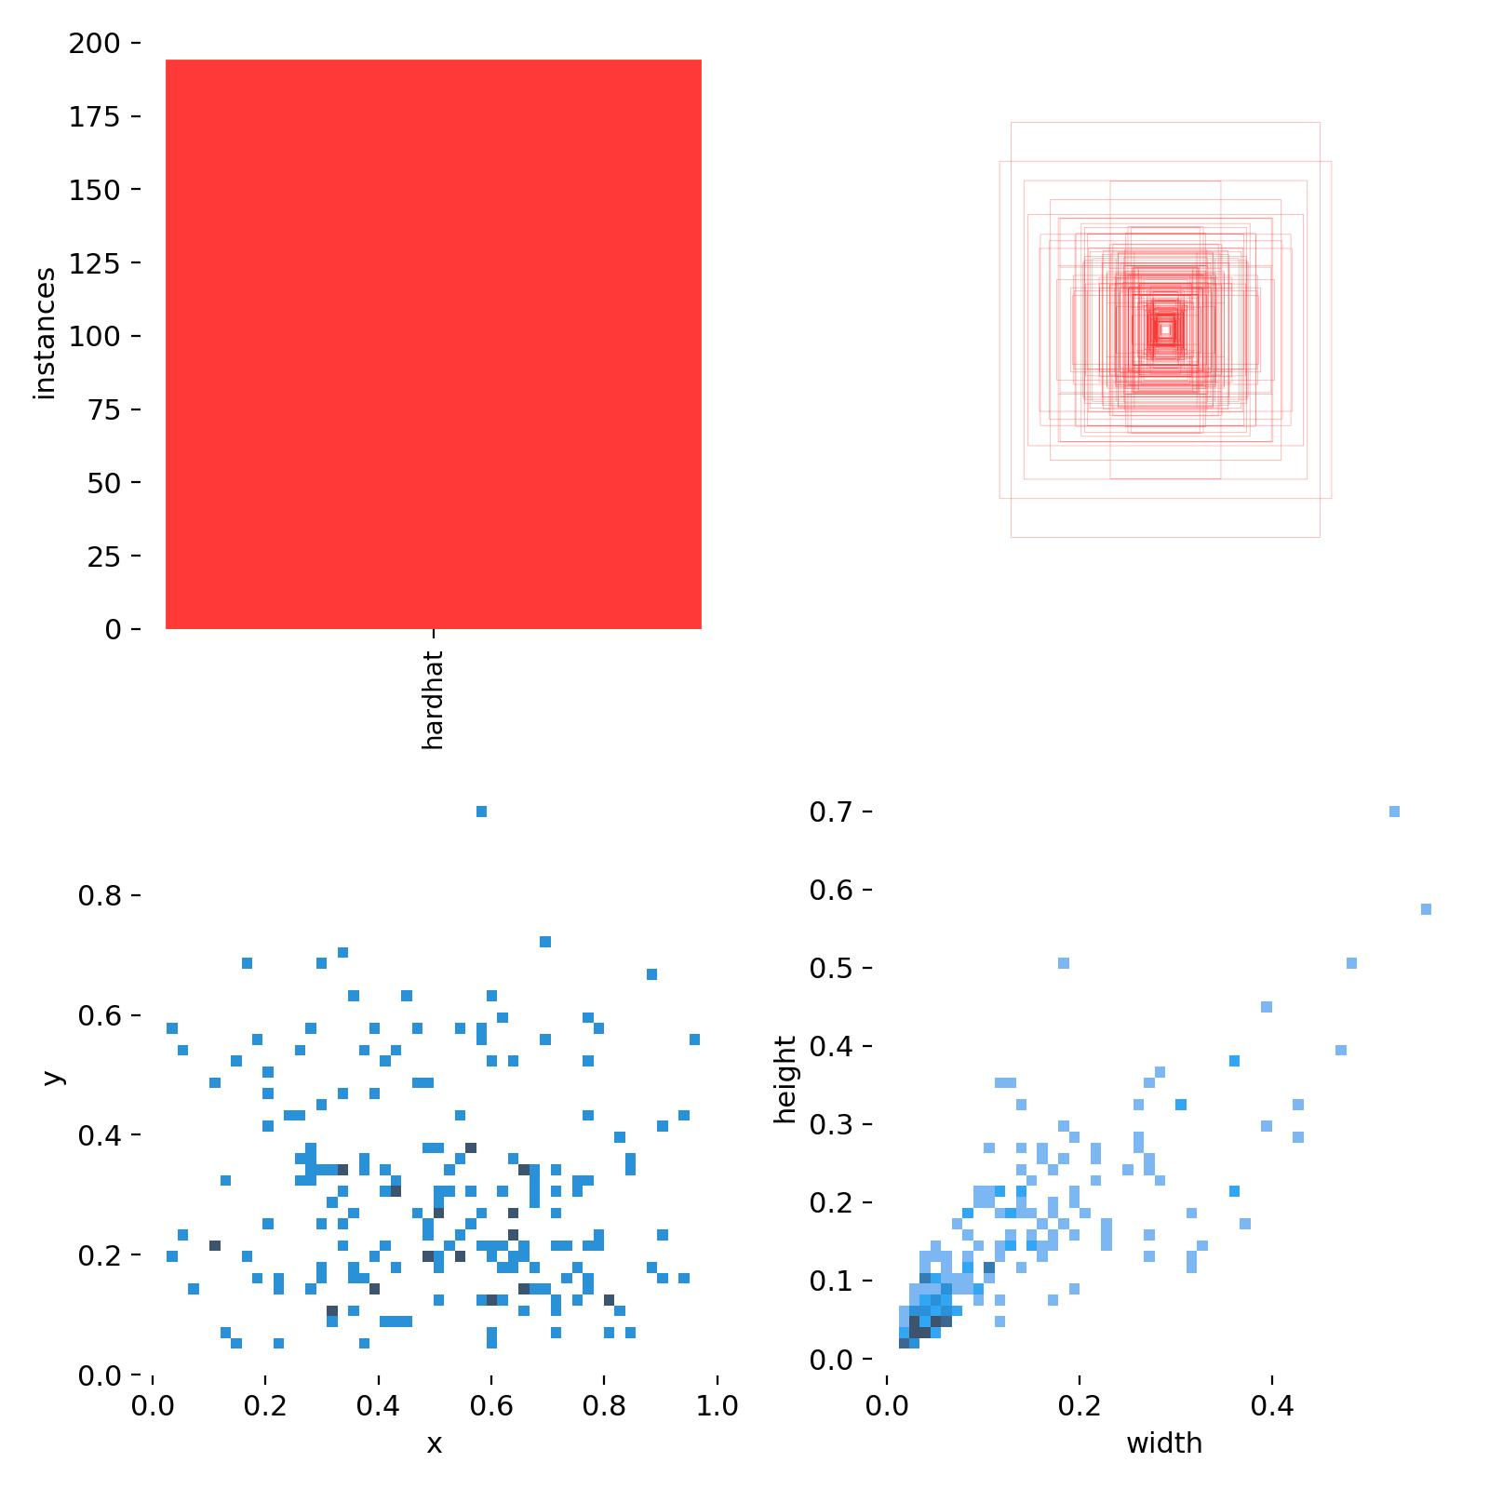
Labels Statistic
These graphs show various statistics about the labels from the images I have annotated.

Slide 17
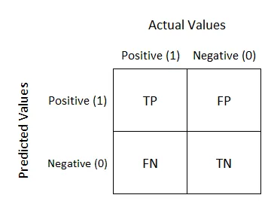
Confusion Matrix
False Positive is a Type I Error
False Negative is a Type II Error
Notes:
https://manisha-sirsat.blogspot.com/2019/04/confusion-matrix.html

Slide 18
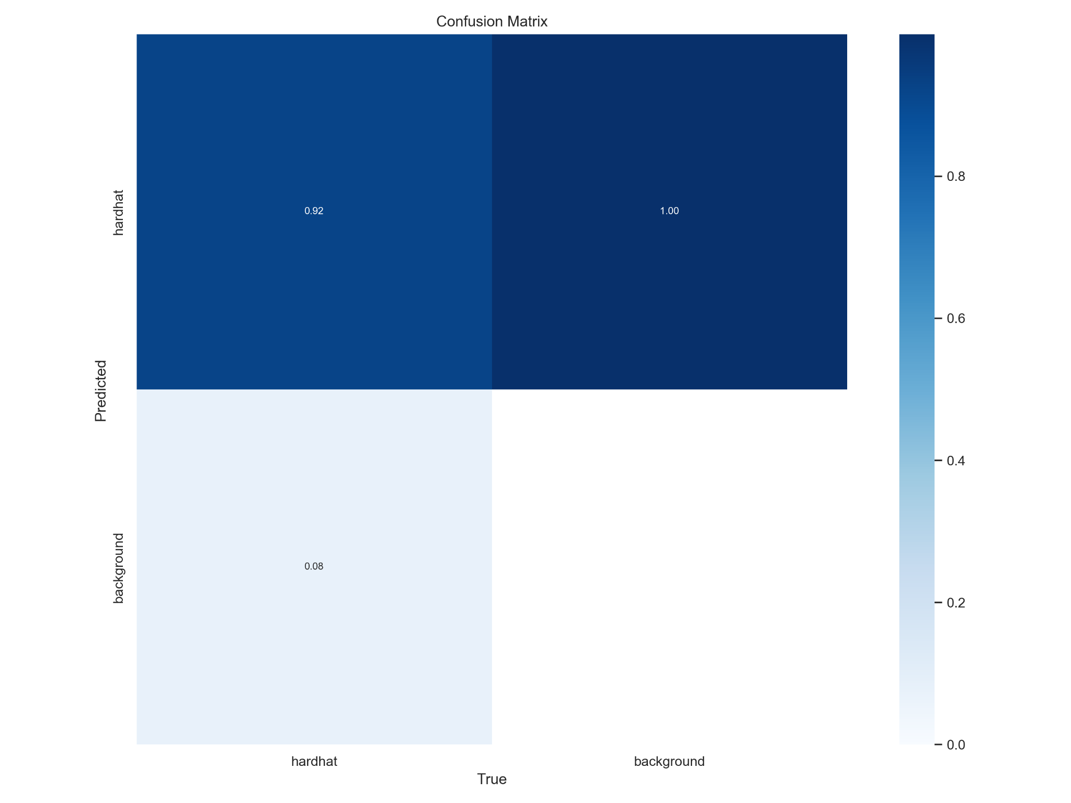
Confusion Matrix from hardhat detection model
(Background is not actually predicted and the columns are normalized, making right hand side 1.00 and 0)

Slide 19
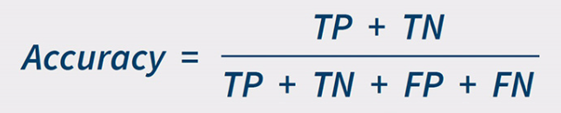
Accuracy
Accuracy is True Positives and True Negatives out of all the samples
0.92 for the hardhat detection model I have created
Notes:
https://manisha-sirsat.blogspot.com/2019/04/confusion-matrix.html

Slide 20
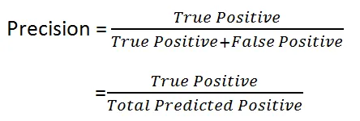
Precision
Confidence is how certain the model is that the prediction is correct (again, no background (negative) prediction)
Talks about how many of the predicted positives are actual positives
Higher when less positive predictions
Good metric to use when the cost of False Positive is high
Notes:
https://manisha-sirsat.blogspot.com/2019/04/confusion-matrix.html

Slide 21
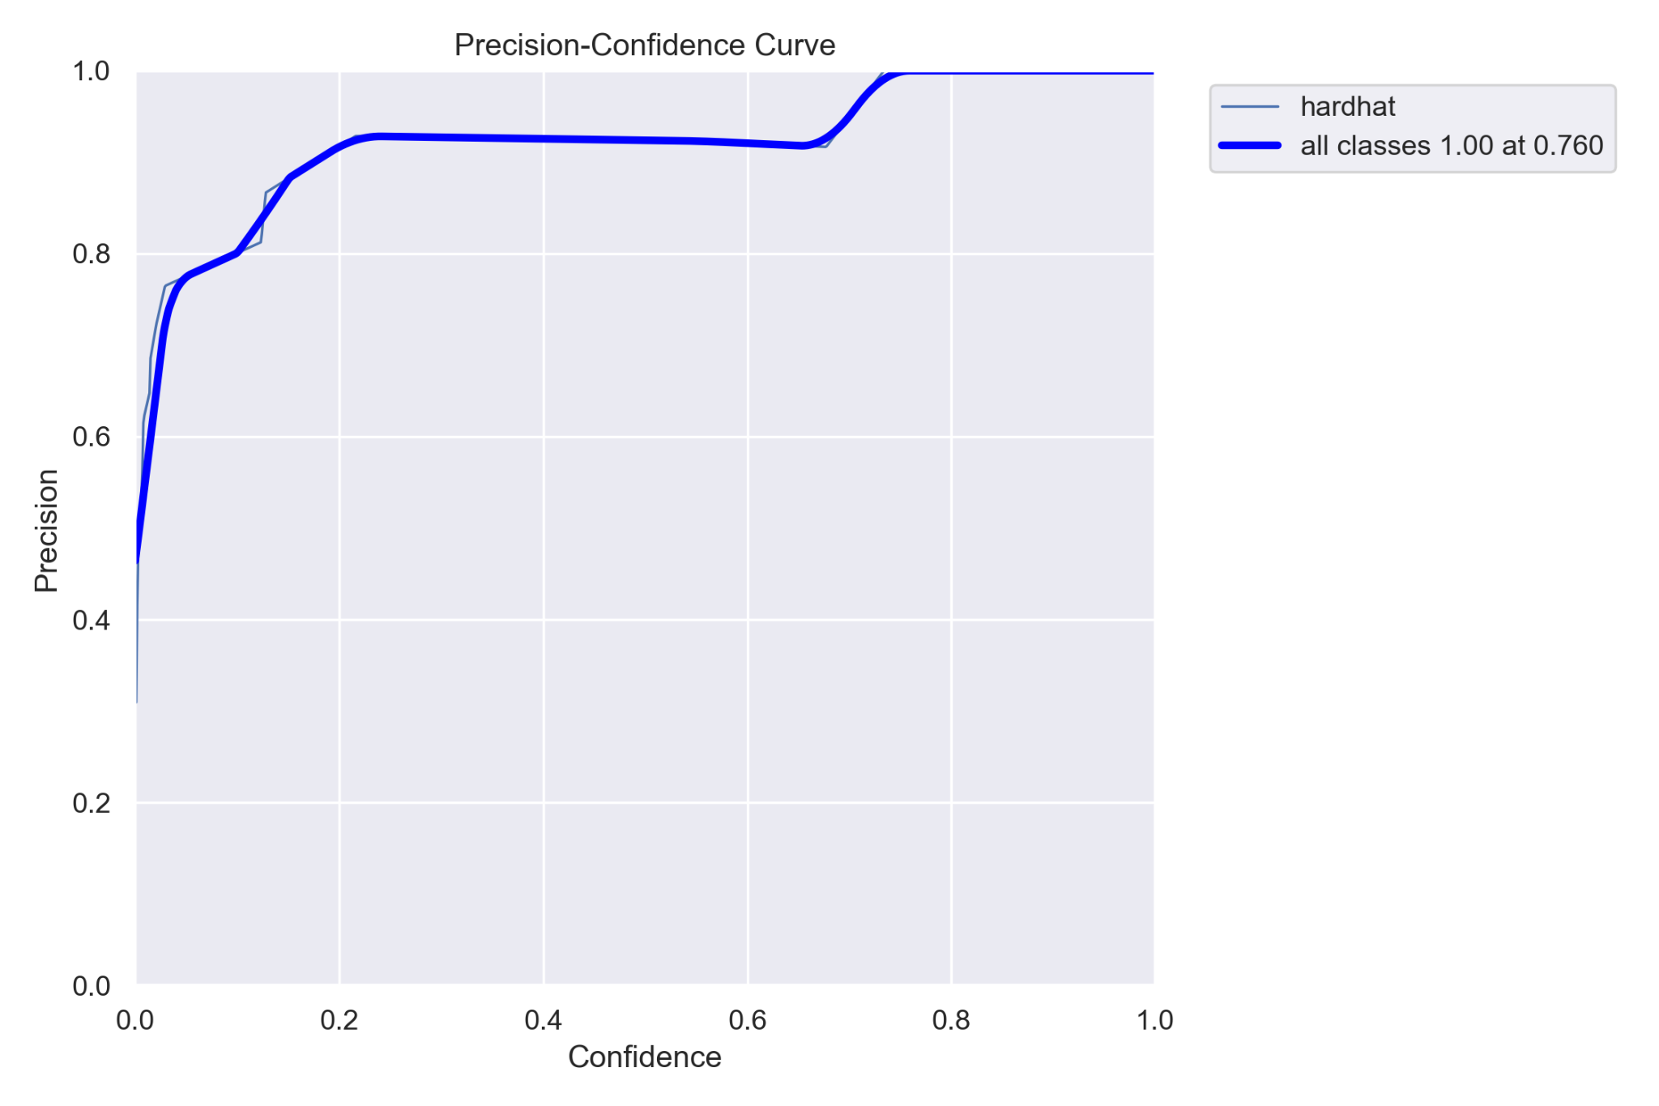
At confidence of 0.76 or higher, there are no False Positives (Type I Error)

Slide 22
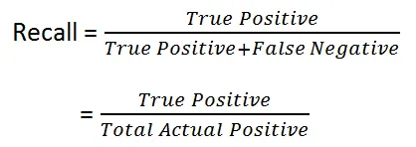
Recall
Confidence is how certain the model is that the prediction is correct (once again, no background (negative) prediction)
Talks about how many of the actual positives are predicted positive
Higher when more positive predictions
Good metric to use when the cost of False Negative is high
Notes:
https://manisha-sirsat.blogspot.com/2019/04/confusion-matrix.html

Slide 23
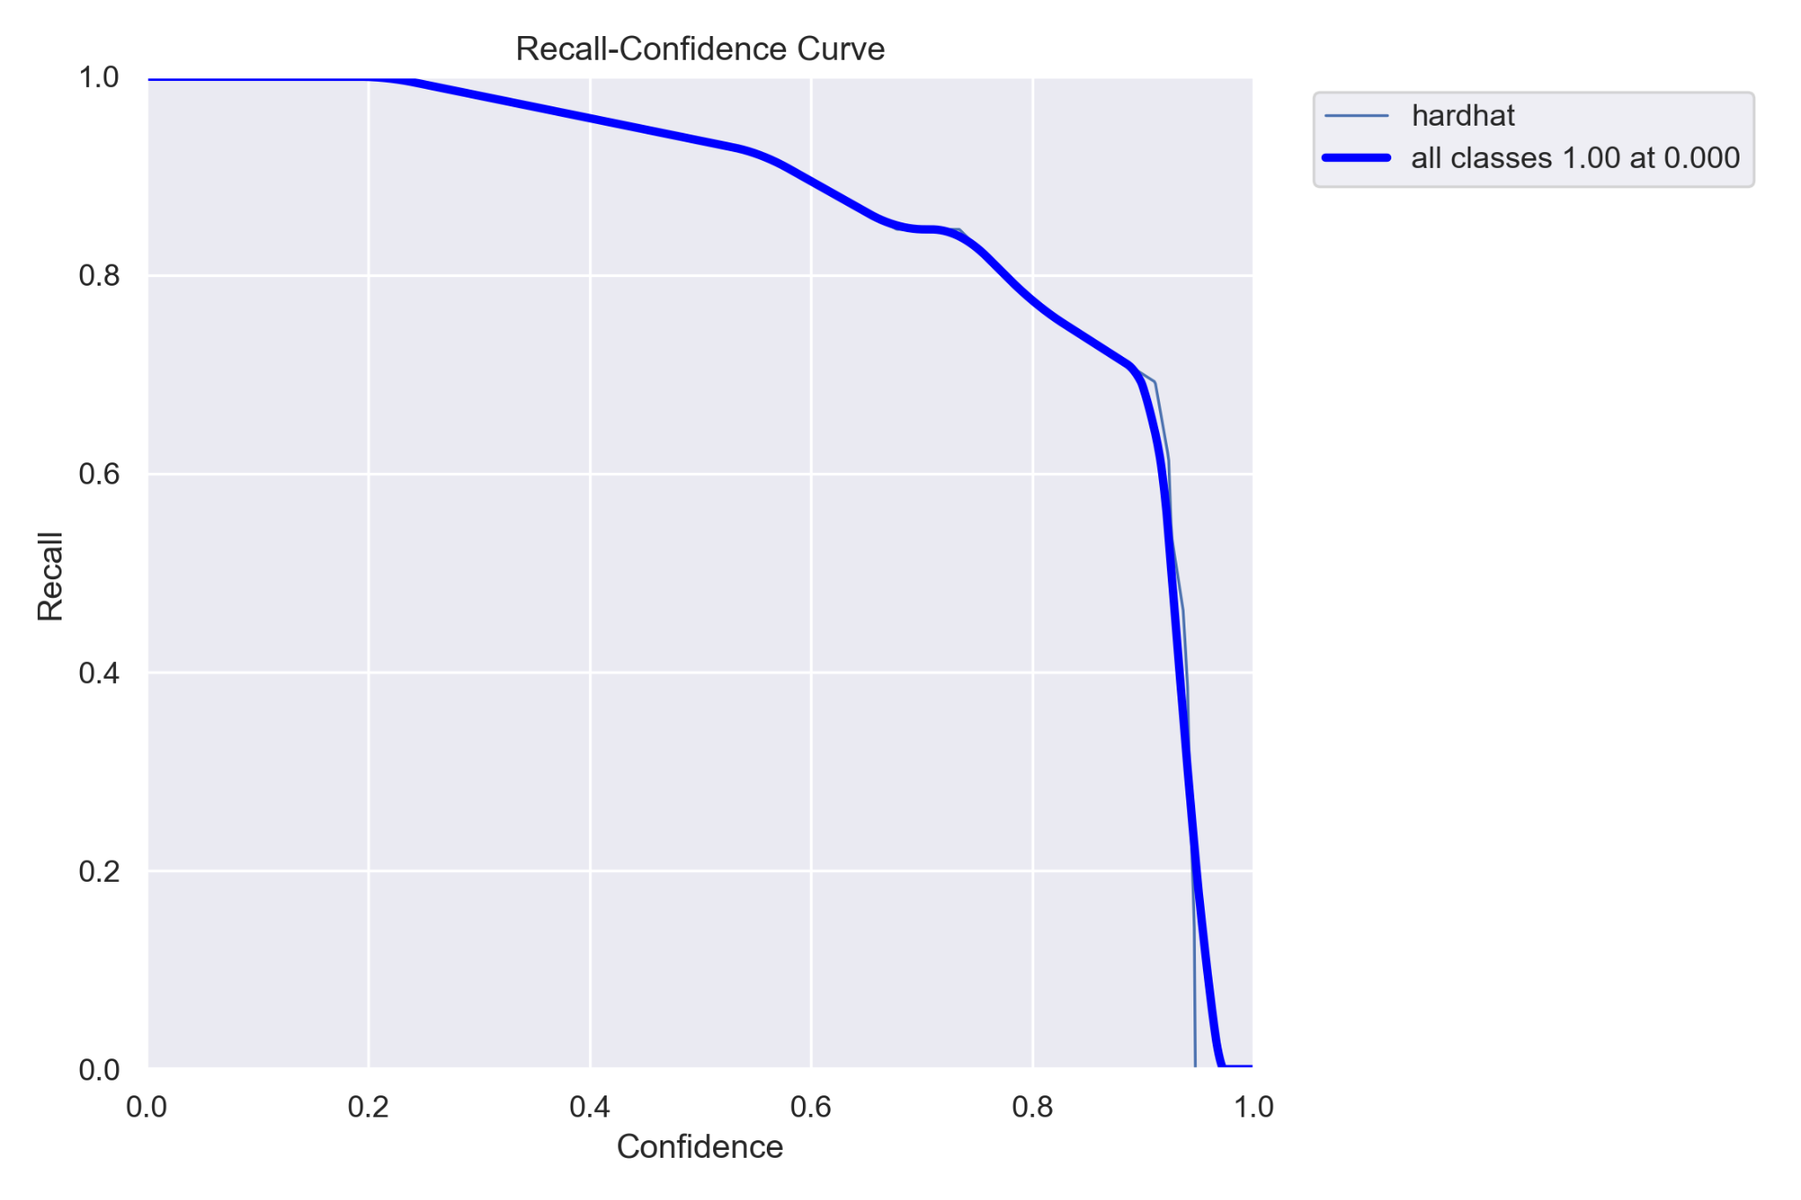
At confidence of 0.76 or higher, there are no False Positives (Type I Error)
At confidence of 0 or lower, there are no False Negatives (Type II Error)

Slide 24
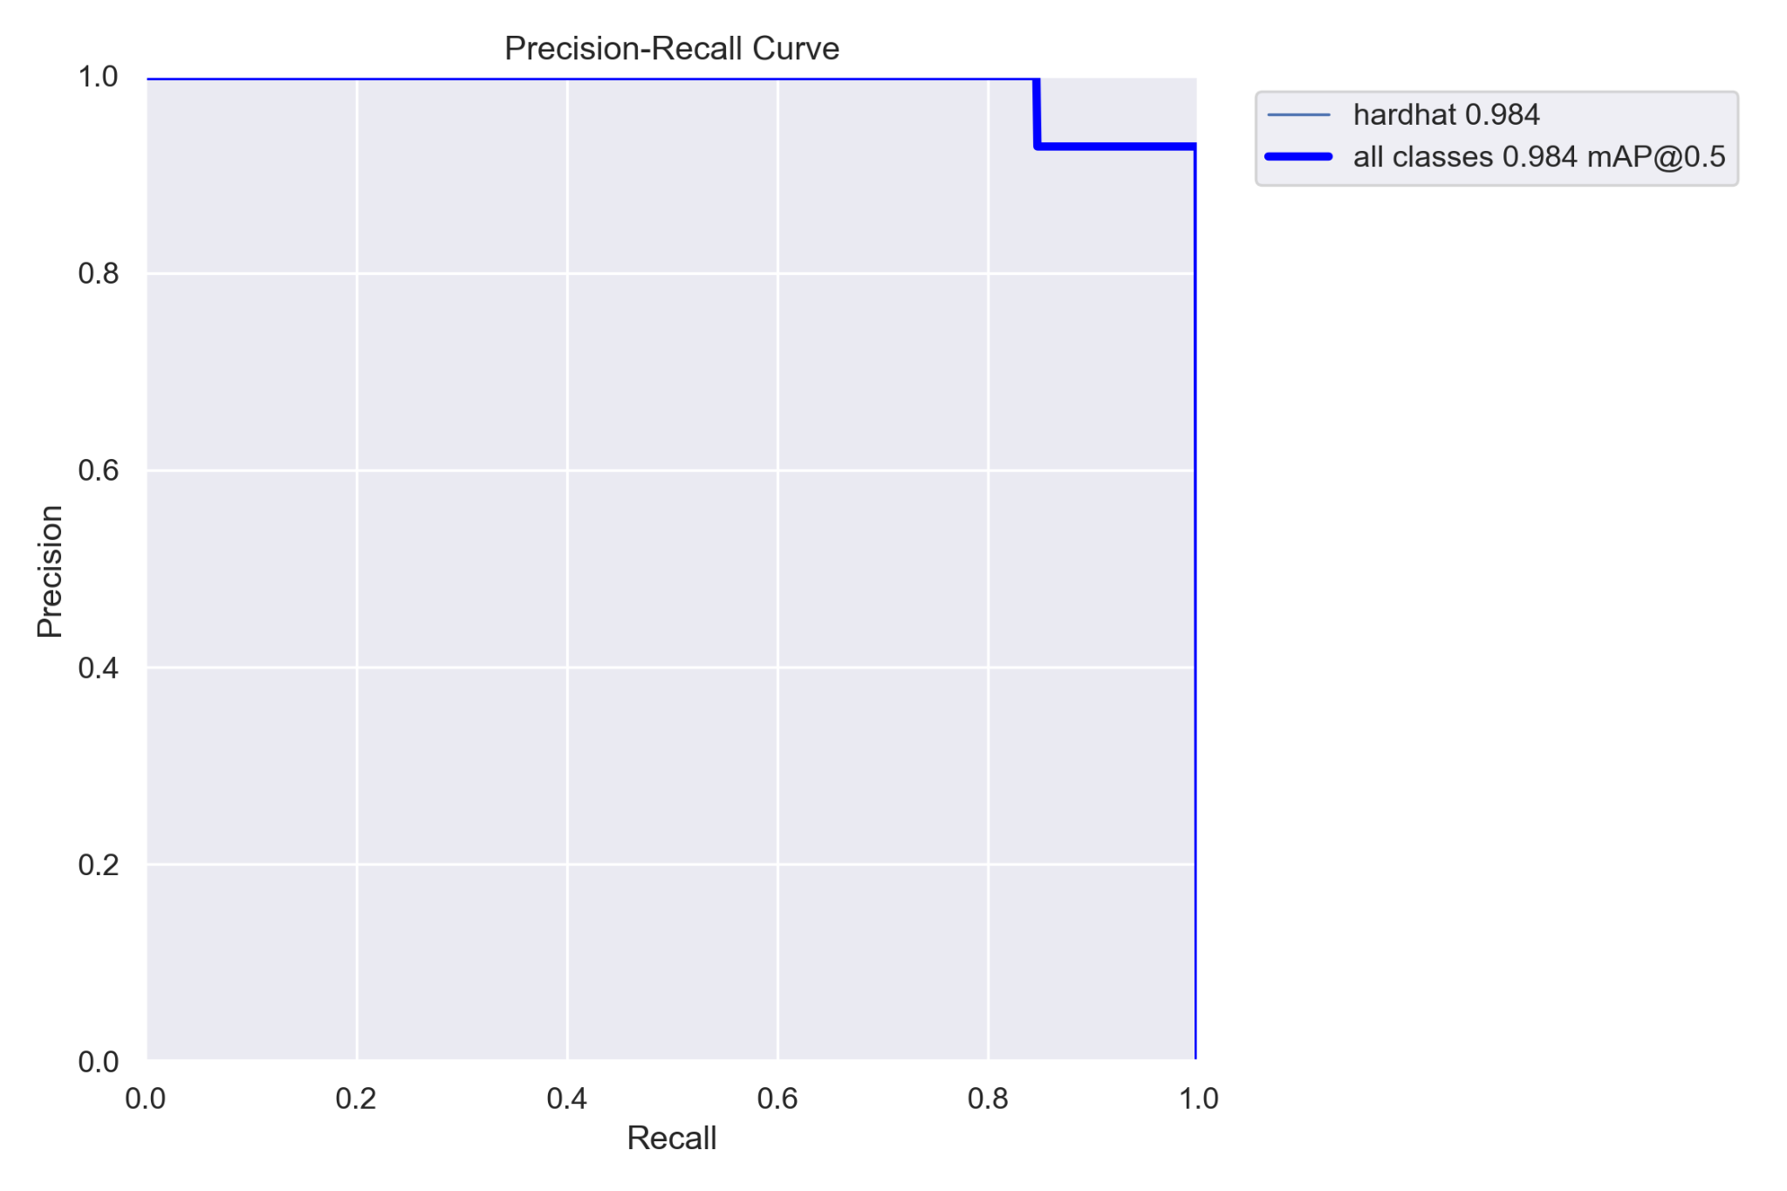
Precision and Recall have inverse relationship

Slide 25
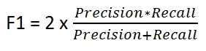
F1 Score
Balance between Precision and Recall
Often better than accuracy
Does not get affected by high True Negatives
Accounts heavily for False Positives and False Negatives, which are often more crucial in real life situations
Example: Model predicts all ISM interviewees to not make ISM while actual values show 10 out of 100 made it
0
0
10
90
Notes:
https://manisha-sirsat.blogspot.com/2019/04/confusion-matrix.html

Slide 26
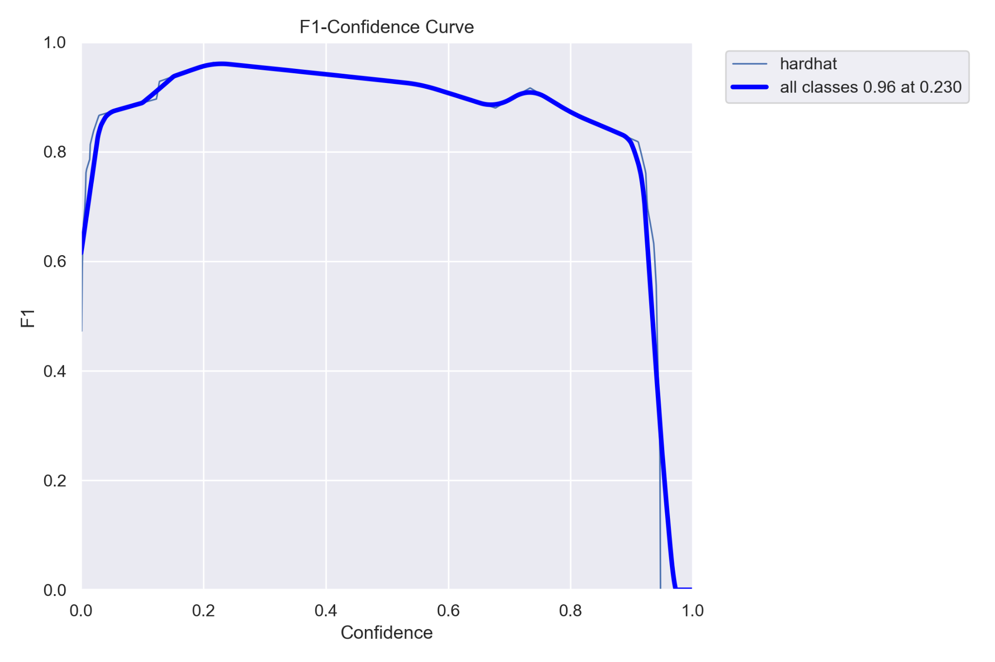
A good balance between Precision and Recall is at confidence of 0.23 with F1 Score of 0.96

Slide 27
Real World Application

Slide 28

Thank You
Digital Portfolio

